Slide 1






E-Commerce Sales Analysis
Student Details
Name: KARTHI M
NM Id: autle-09eee
College Name: KINGSTON ENGINEERING COLLEGE

Slide 2
E-Commerce Sales Analysis
Disclaimer
The content is curated from online/offline resources and used for educational purpose only

Slide 3

Course Outline
E-Commerce Sales Analysis
Abstract
Problem Statement
Aims, Objective & Proposed System/Solution
System Deployment Approach
Model Development & Algorithm
Future Scope
Video of the Project
Conclusion
Reference

Slide 4


E-Commerce Sales Analysis
Abstract
The world economy is witnessing a transition. All companies are transformed into information-based operations through online technologies. The pace of technical transition is so exponential that modern electronic commerce is now making significant shifts in the economic environment, impacting all areas of industry. The Web has expanded companies' scope. The vast quantity of business information made accessible by the global network that facilitates the gathering of information between firms, a corporation, its clients and the various divisions of a business is increasing exponentially. The information-based virtual value chains for any company cannot be overlooked operationally or strategically. This review article discussed the aspects of electronic commerce including its importance, facilitators, benefits, challenges and scope in the Indian market.

Slide 5


E-Commerce Sales Analysis
Problem Statement
Customer Behavior Understanding: Understanding customer behavior is crucial for e-commerce success. Businesses need to analyze browsing patterns, purchase histories, demographics, and preferences to personalize marketing efforts, optimize product offerings, and improve customer retention. However, extracting actionable insights from disparate data sources and understanding evolving consumer trends pose significant challenges.
Data Overload: E-commerce platforms generate immense volumes of data from various sources, including website traffic, transaction records, customer interactions, and marketing 1 campaigns. The sheer volume and variety of data make it challenging for businesses to extract meaningful insights efficiently.

Slide 6

E-Commerce Sales Analysis
Aim and Objective
The aim of eCommerce sales analysis is to gain insights into customer behavior, product performance, and overall business trends to optimize sales strategies and maximize revenue. Algorithms used in this analysis often include

Slide 7
E-Commerce Sales Analysis
Objectives
Identifying Sales Patterns: Analyze sales data to identify trends, patterns, and seasonality in customer purchasing behavior. This helps in understanding when and what customers are buying, enabling better inventory management and targeted marketing campaigns.
Customer Segmentation: Segment customers based on various factors such as demographics, purchase history, and behavior. By understanding different customer segments, businesses can tailor marketing strategies, promotions, and product offerings to better meet the needs and preferences of each group.
Performance Evaluation: Evaluate the performance of different products, categories, and marketing channels to identify top-performing and underperforming areas. This insight can inform decisions regarding product assortment, pricing strategies, and allocation of marketing resources.
Conversion Rate Optimization: Analyze the sales funnel to identify bottlenecks and areas for improvement in the conversion process. By optimizing elements such as website design, checkout process, and product descriptions, businesses can increase conversion rates and maximize sales.
Customer Lifetime Value (CLV) Analysis: Calculate the CLV of customers to understand their long-term value to the business. By identifying high-value customers, businesses can prioritize retention efforts and tailor marketing strategies to maximize customer lifetime value.

Slide 8

E-Commerce Sales Analysis
Proposed Solution
Collect sales data from various sources, including e-commerce platforms, point-of-sale systems, customer relationship management (CRM) systems, and marketing channels.
Analyze product performance metrics, including sales volume, revenue, profitability, and inventory turnover.
Determine the contribution of each sales channel to overall revenue and assess channel effectiveness in reaching target customers.
Build predictive models using machine learning algorithms to forecast future sales trends, demand patterns, and customer behavior
Notes:
‹#›

Slide 9
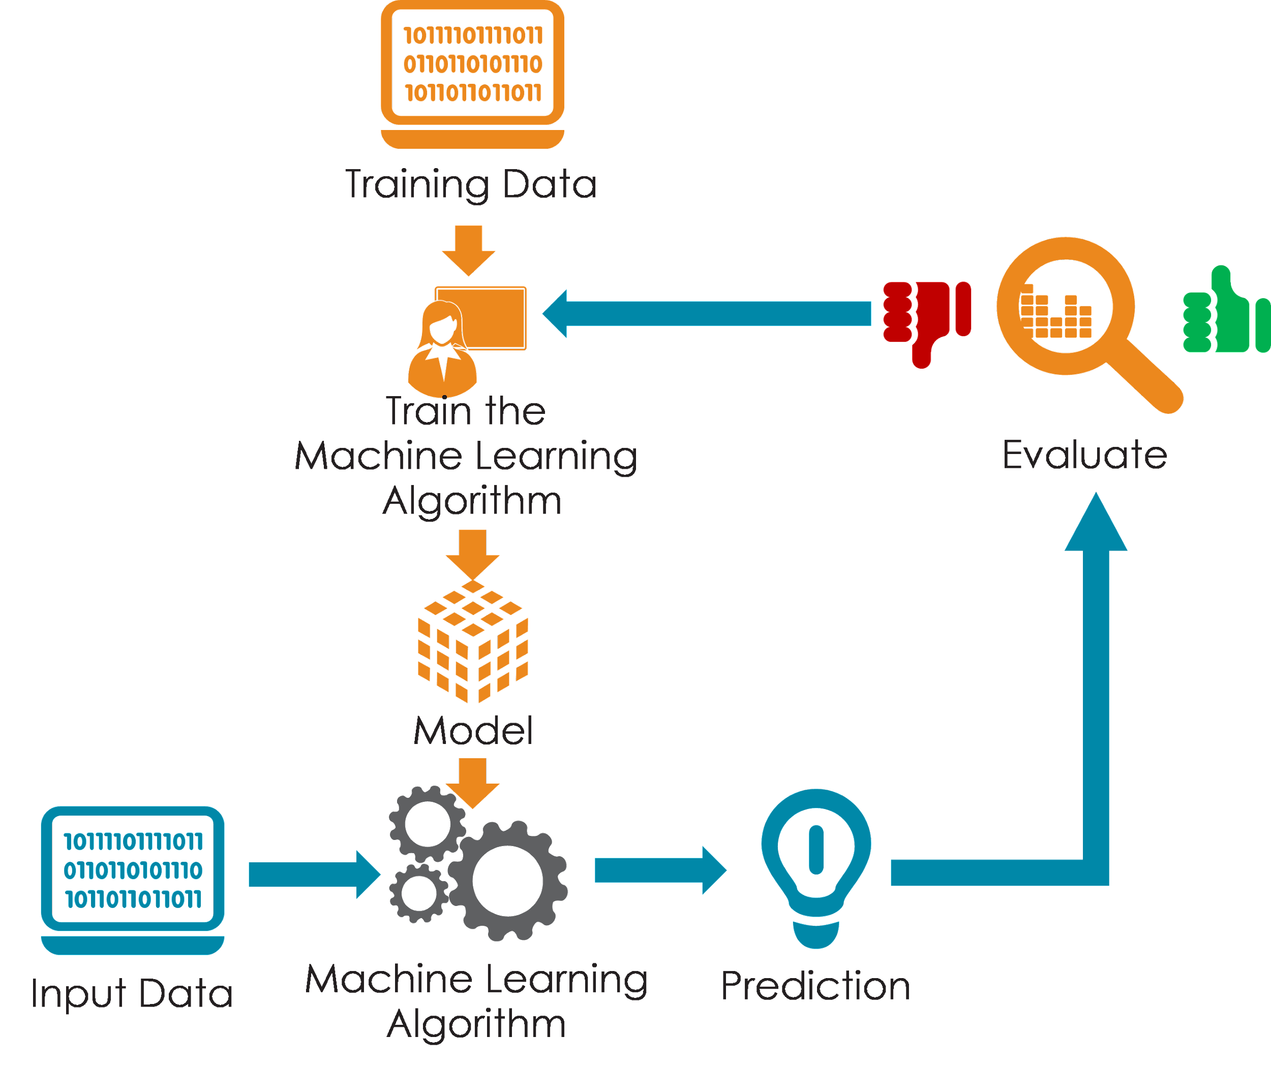
E-Commerce Sales Analysis
System Deployment Approach
Notes:
‹#›

Slide 10
E-Commerce Sales Analysis
Model Development & Algorithm
Dataset Description:
The dataset contains customer details
Size of dataset is 10000
Categorized into five classes
Address,Browser info,company,Email,IP address
Each Row has around 10000 data’s
Notes:
‹#›

Slide 11
E-Commerce Sales Analysis
Model Development & Algorithm
Regression algorithm
The regression algorithm is widely used in forecasting. The two main techniques are the following:
Linear regression. The linear regression in AI supports sales forecasting. It helps businesses predict future sales based on historical data, seasonality, and other factors.
Time series forecasting. This kind of algorithm includes, for example, the ARIMA model. Long Short-Term Memory (LSTM) neural networks are tailored to predict trends and forecast how the inventory should be enhanced.
Clustering algorithms
This one is similar to the mechanic segmentation in manual or automated systems. The two examples below are used to categorize whatever you need, from customers to products and more.
K-Means. This one groups customers based on similar behavior. The data received allow for targeted marketing and personalized product recommendations.
Hierarchical clustering. What can be better than the hierarchical categorization of products in an inventory? The technique helps organize products into categories and, further, subcategories.
Notes:
‹#›

Slide 12

E-Commerce Sales Analysis
Future Scope
Advanced Predictive Analytics: E-commerce sales analysis will increasingly leverage advanced predictive analytics techniques, such as machine learning and AI, to forecast sales trends, identify customer preferences, and optimize pricing strategies in real-time.
Personalized Customer Experience: The future of e-commerce sales analysis will focus on delivering hyper-personalized customer experiences.
Real-Time Analytics: Real-time analytics capabilities will become increasingly important for e-commerce sales analysis.
Augmented Analytics: Augmented analytics, which combines AI and natural language processing (NLP) technologies, will empower businesses to derive insights from e-commerce sales data more intuitively and efficiently.
Notes:
‹#›

Slide 13
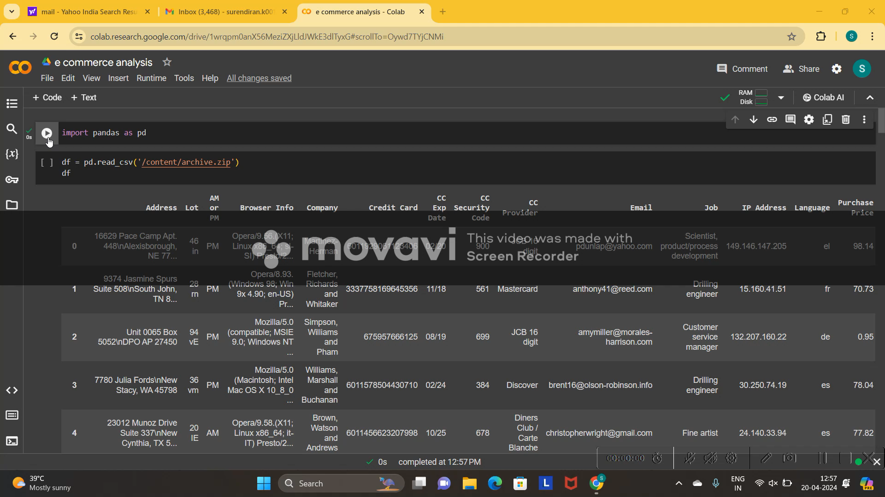
E-Commerce Sales Analysis
Video of the Project
Notes:
‹#›

Slide 14

E-Commerce Sales Analysis
Conclusion
In summary, in the years to come, the industry of electronic commerce will be a one of the leading sector in the field of electronic business. The revolution in electronic commerce has huge positive impact on the transaction industry by fast offering new markets and crossing edges. It greatly affected the conventional market system in the world and made it possible to improve the lives of people. Although it provides customers and sellers rewards, e-commerce poses conventional businesses with obstacles to a sustainable place. Developing countries pose a range of challenges to the effective conduct of e-commerce when contrasting it with developing countries. When Internet prices are minimal, e-commerce flourishes quickly and many companies are typically drained. Convenience is one of the major advantages of electronic commerce for consumers and thus increasing customer loyalty. This is because consumers can put orders via internet access from anywhere they are. Company e-commerce offering a seamless operation and multiple payment choices should be essential to any customer and provide more functions accessible online. Other advantages include expanded products and enhanced regional coverage. However, e-commerce companies face many challenges in their expansion.
Notes:
‹#›

Slide 15
E-Commerce Sales Analysis
Reference
[1] Han, Jiawei, Micheline Kamber, and Jian Pei. “Data mining: concepts and techniques” Morgan kaufmann, 2006.
[2] Quinlan J. R. (1986). “Induction of decision trees.Machine Learning,” Vol.1-1, pp. 81-106.
[3] J. R. Quinlan, “C4.5: Programs for Machine Learning,” Morgan Kaufmann Publishers, Inc., 1993.
Notes:
Reference
These are the references for this session.

Slide 16
E-Commerce Sales Analysis
Thank you!
Notes:
‹#›

